Slide 1
SESAR Codes

Slide 2
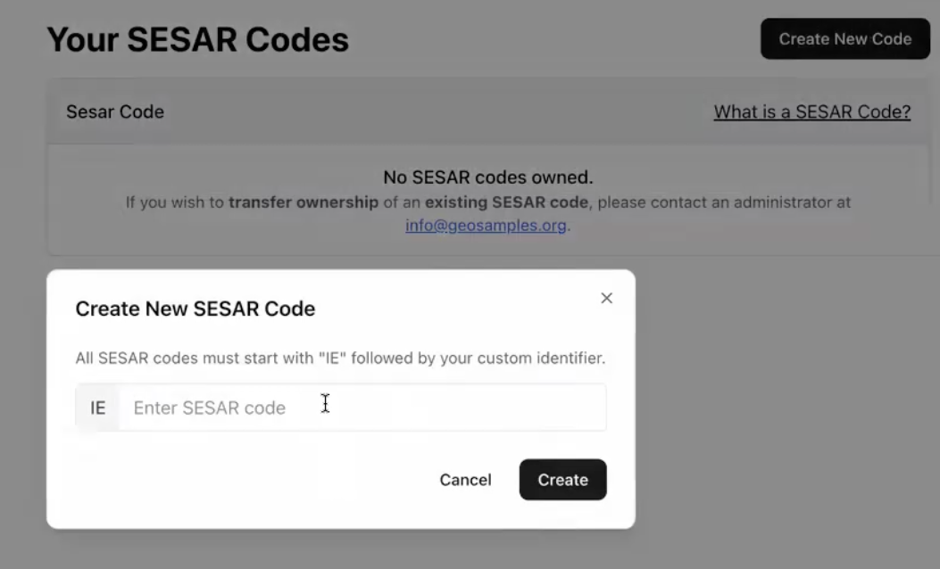
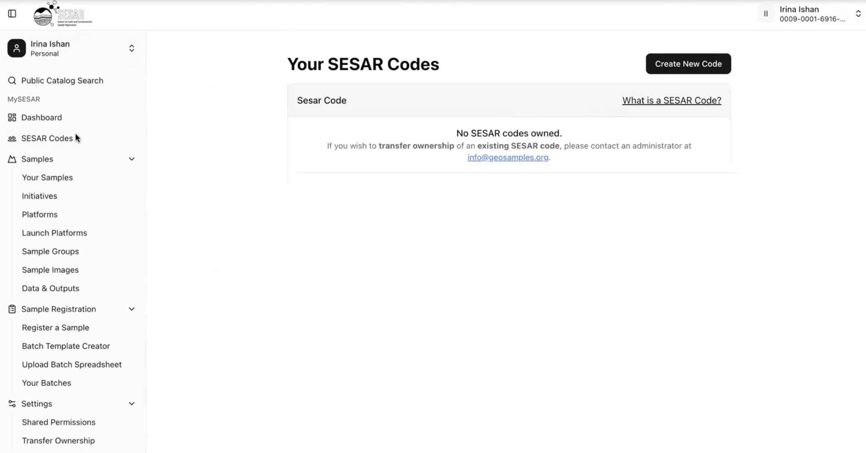
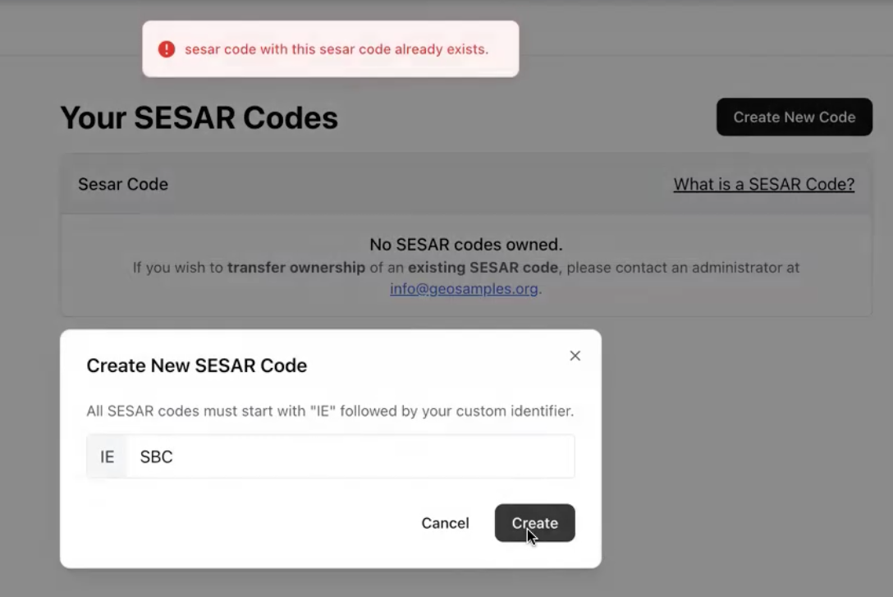
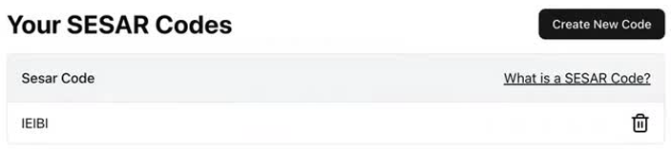
Creating a SESAR CODE
2
1
3
4
Under the left side panel, click SESAR Codes to create, delete, and access existing SESAR Codes.
Click Create New Code and enter a three character code of any alpha-numeric combination.
If a code is already in use, the system will flag it. Please try again.
Successful codes will be added to Your SESAR Code page.

Slide 3
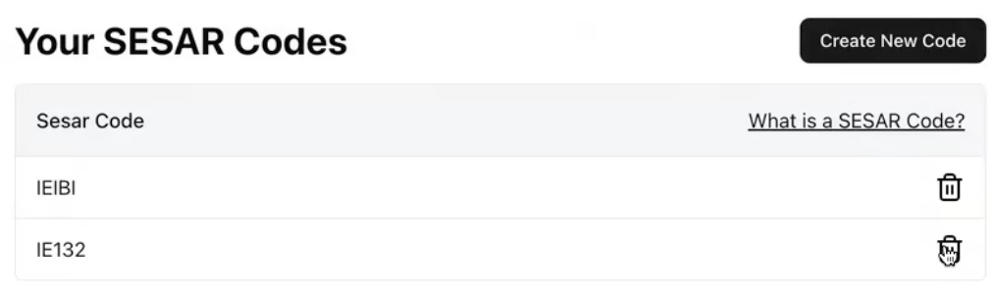
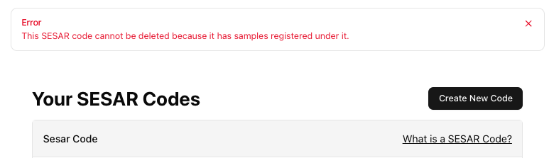
Deleting a SESAR Code
Use the trash button to delete SESAR Codes.
Please note, only SESAR Codes without any samples associated with it can be deleted.

Slide 4
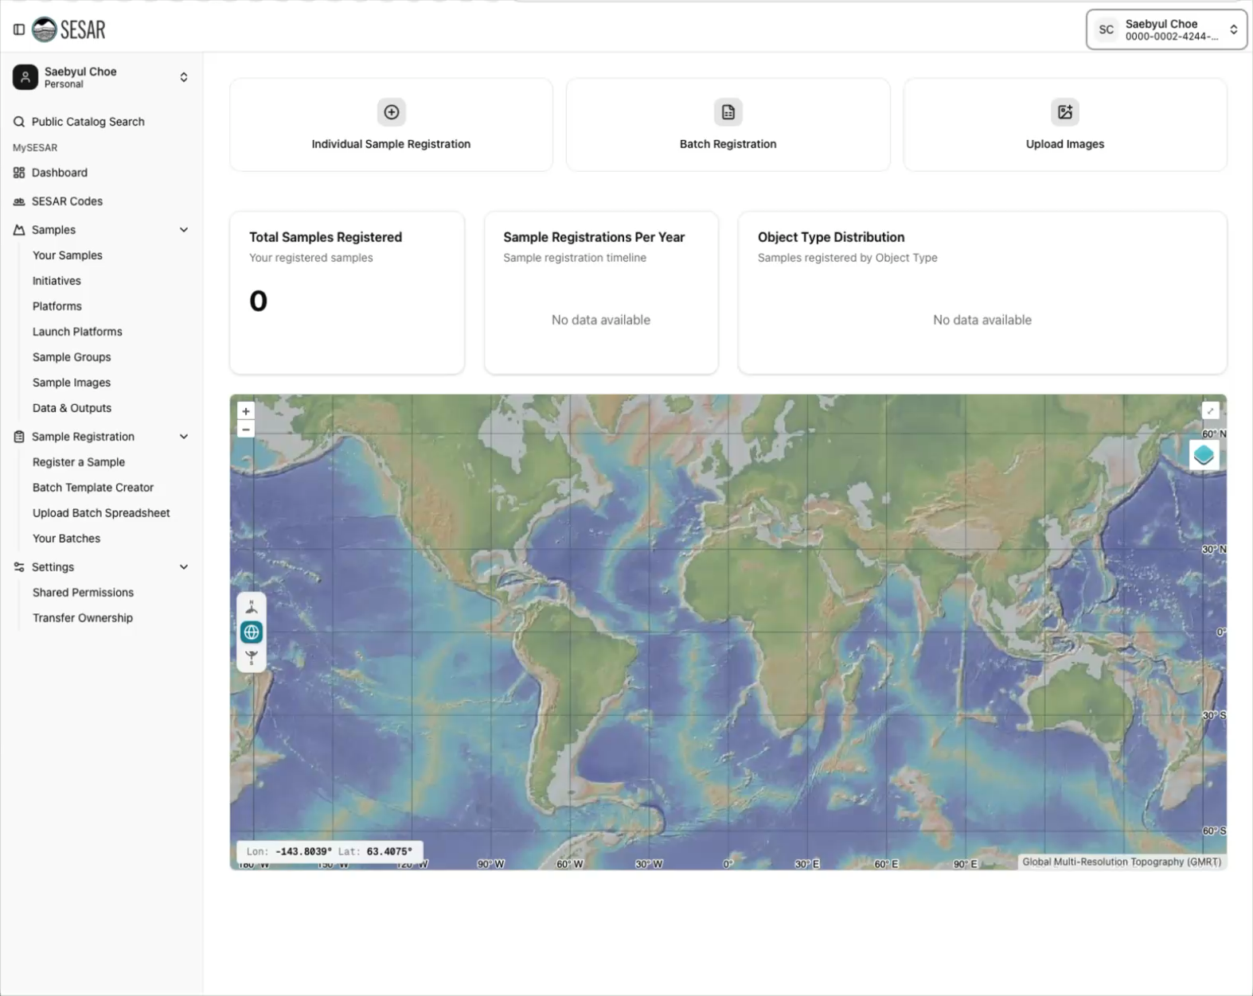
VIDEO Tutorial

